Slide 1

Analysing Amazon’s fulfillment centers’ location rationale
ISM 6423 - Group 14
APRIL 19, 2022
EDYZBELLY FLORES
SATHVIK GANTA
NAROTTAM JAJODIA
LENORD WHITE
DYLAN BERRIER

Slide 2
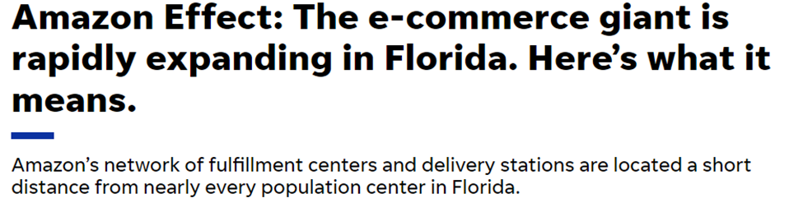
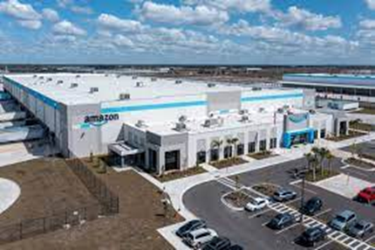
Introduction
Amazon has rapidly expanded its distribution network in Florida as well as across the United States
In 2020 Amazon had 29 logistics facilities but has since added 56 more
Amazon has recently begun to locate facilities in less populated areas
Amazon is on track to expand its network of distribution centers and delivery stations by 40%
Source: The Daytona Beach News-Journal: Amazon Effect: The e-commerce giant is rapidly expanding in Florida, Here’s what it means.
Notes:
Talking point: Facilities were traditionally near major highways, ports, and airports but this is now changing
Source:
https://www.gainesville.com/in-depth/business/economy/2022/03/16/florida-amazon-expansion-rapid-growth-new-facilities-projects/6723912001/?utm_source=facebook&utm_medium=Social&utm_campaign=ghf-gainesville-main&fbclid=IwAR1u4i6TbTjvNAicYuTpBn3JngsaO5HIKXdM8-F4WLKMufciFAQUD8un4Kc

Slide 3
Business Problem
Methodology
Can Amazon’s facility location be explained using Census data and other factors?
To answer this question we looked at 8 states located in Southeast USA. They are Florida, South Carolina, Tennessee, Alabama, Georgia, North Carolina, Kentucky, and Mississippi.
For each state we collected and analysed data for cities with Amazon Facilities and those without, using 10 variables.
Notes:
Data reviewed: Population, Median Household Income, High School Graduate, Bachelor's Degree Graduate, Corporate Income Tax Rate, Households, People of Color, Center, Median Real Estate Taxes, Average Industrial Electricity Rates
We were able to scrape the web to find this data.
Source: https://www.gainesville.com/in-depth/business/economy/2022/03/16/florida-amazon-expansion-rapid-growth-new-facilities-projects/6723912001/?utm_source=facebook&utm_medium=Social&utm_campaign=ghf-gainesville-main&fbclid=IwAR1u4i6TbTjvNAicYuTpBn3JngsaO5HIKXdM8-F4WLKMufciFAQUD8un4Kc

Slide 4
Data Sources
https://en.wikipedia.org/wiki/List_of_Amazon_locations#United_States
https://www.census.gov/
https://floridarevenue.com/
https://taxfoundation.org/publications/state-corporate-income-tax-rates-and-brackets/
https://info.siteselectiongroup.com/blog/power-in-the-data-center-and-its-costs-across-the-united-states

Slide 5
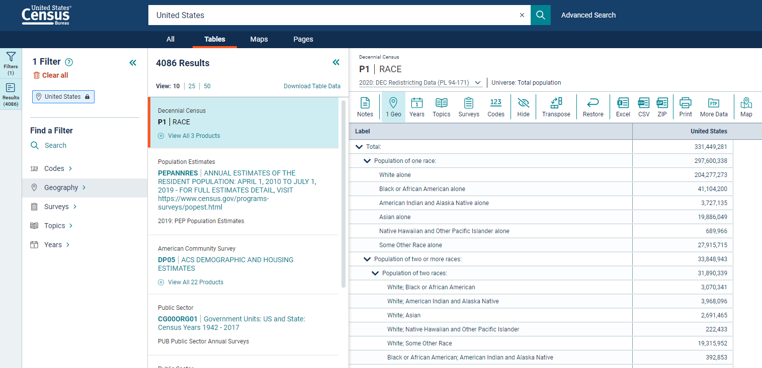
Data Sources

Slide 6
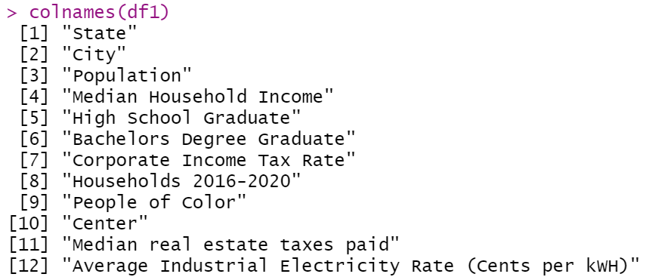
Description of the Data - Variables

Slide 7
Description of the Data - Data Wrangling
Most variables were joined using city or state as primary key.
‘People of Color’ variable was calculated by deducting white population proportion from 100%.
Converted % values to discrete numbers

Slide 8
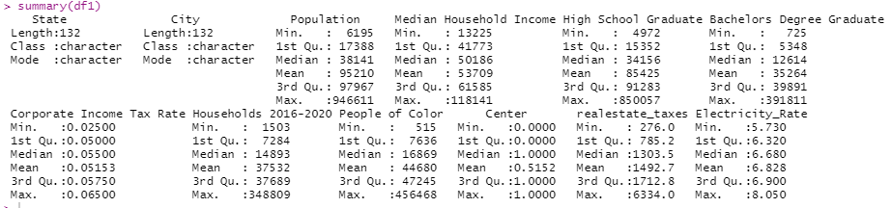
Description of the Data - Summary

Slide 9
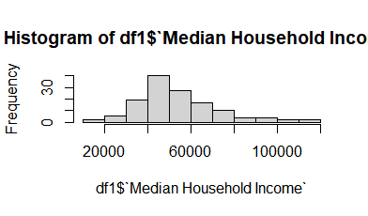
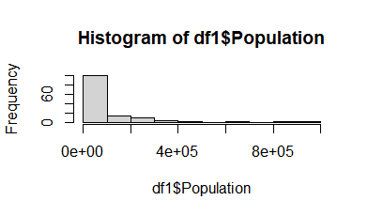
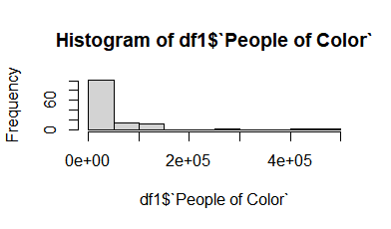
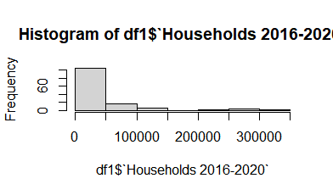
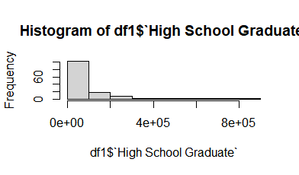
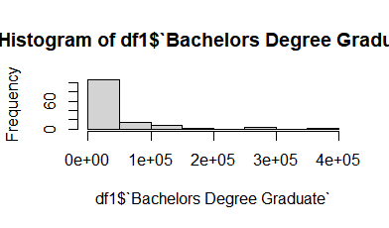
Description of the Data - Variable analysis

Slide 10
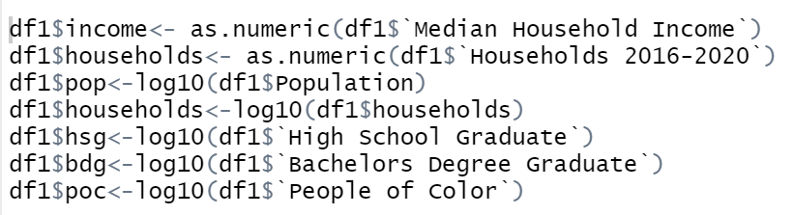
Description of the Data - Transform skewed Data

Slide 11
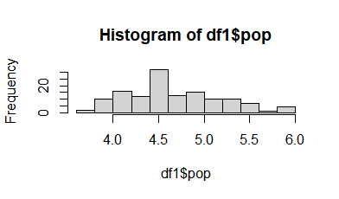
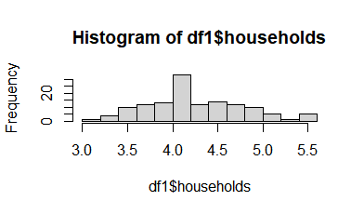
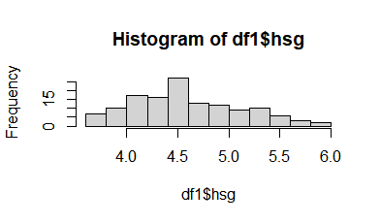
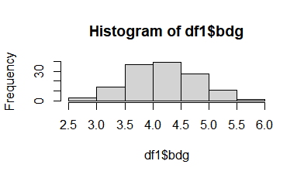
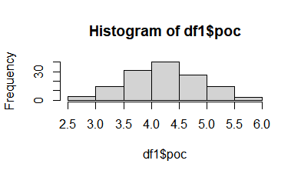
Description of the Data - Variable analysis of Transformed Data

Slide 12
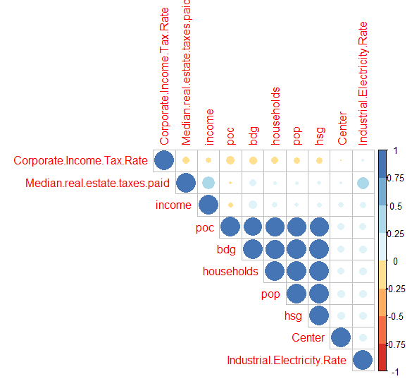
Correlation Matrix
The Correlation Matrix shows that the variables bdg, households, population, hsg and poc are highly correlated with each other.
The dependent variable Center shows low correlation with other variables.
The real estate taxes is moderately correlated with industrial electricity rate and income.
**hsg- high school graduates
**bdg- Bachelor’s degree graduates
**Pop- population
** poc- people of color

Slide 13
Final Dataset for analysis
Excluding redundant and non-normal variables to create final dataset to be used for analysis.
Dependent variable (Y): “Center”
Independent variables (X): "Corporate Income Tax Rate", "realestate_taxes", "Electricity_Rate", "income", "households", "pop", "hsg", "bdg", "poc".
Since the dependent variable is binomial, we will use the logit regression analysis for categorical predicted data type.

Slide 14
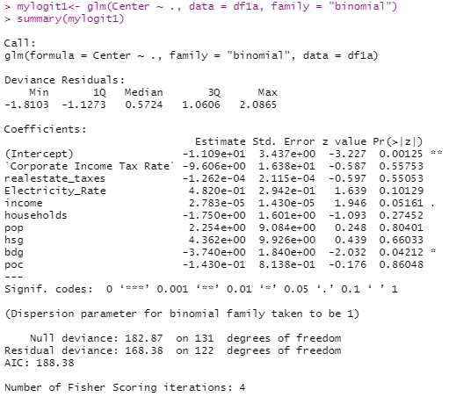
Analysis
Using all independent variables to run a glm regression.
None but one variable is significant (p-value).
‘Bdg’ (Bachelor's degree graduate) has weak significance.
Regression should be re-run using a subset of variables.

Slide 15
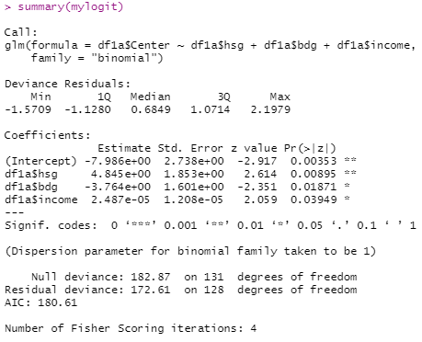
Analysis
Using 3 independent variables to run a glm regression.
‘Hsg’ (High School Graduate) variable has moderate significance.
‘Bdg’ (Bachelor's degree graduate) and ‘income’ (Median Household Income) have weak significance.
Regression model is not conclusive.

Slide 16

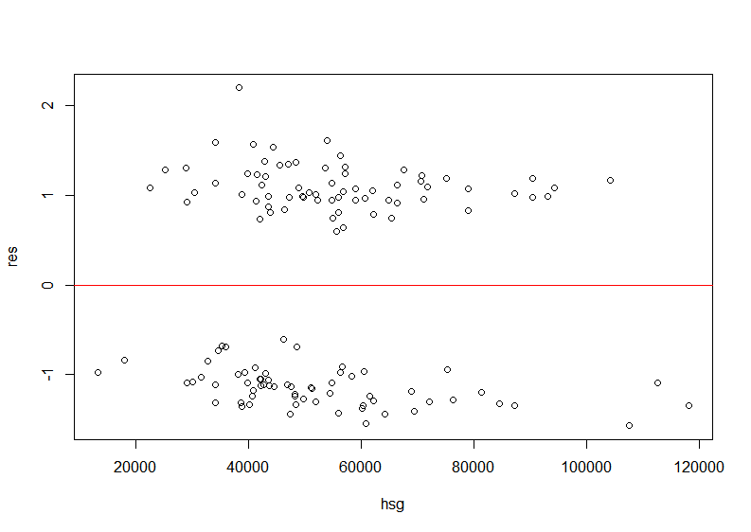
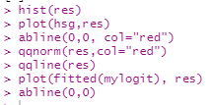
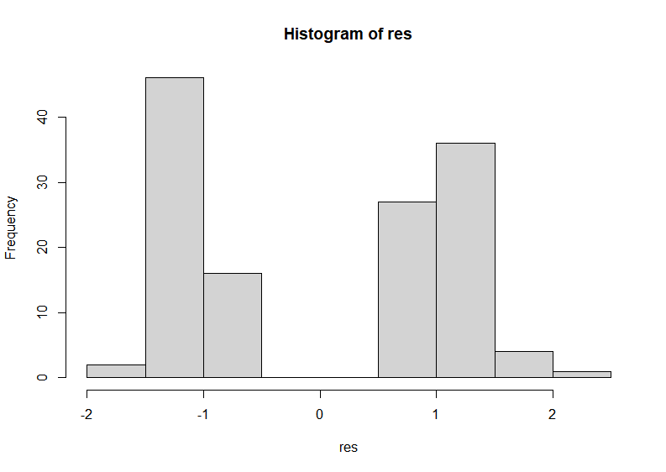
Residual Analysis

Slide 17
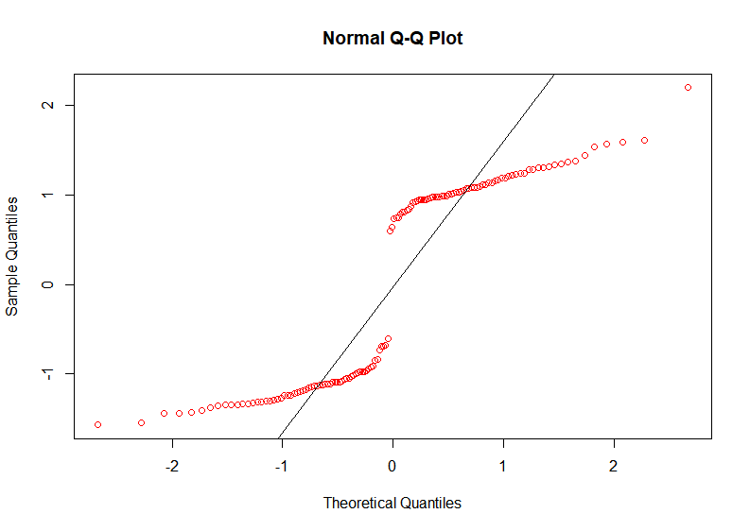
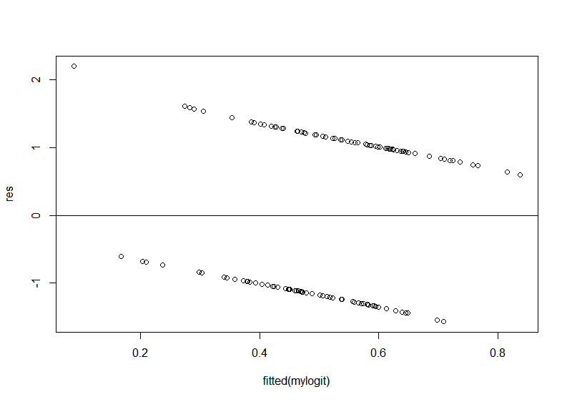
Residual Analysis

Slide 18
Conclusion
From this analysis we can observe that most of the census variables selected cannot be used to explain amazon fulfillment center location rationale.
It can be understood that Amazon uses other factors to make their location decisions.
Adding other variables like land price and property value might increase the model efficiency.
Having Amazon regional sales data could be helpful for this analysis.

